Slide 1
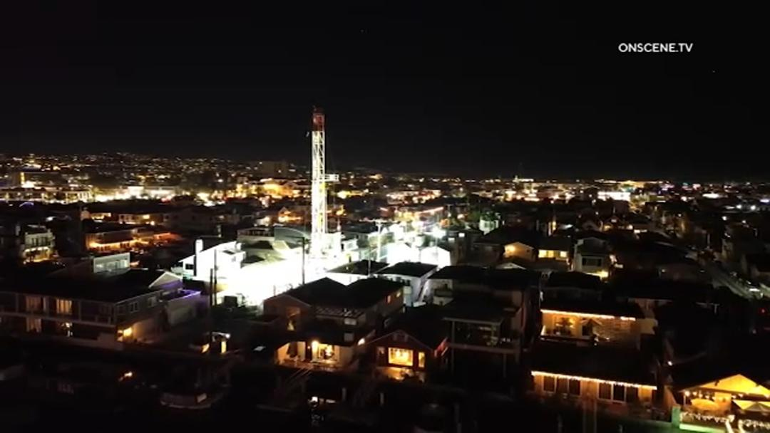
Newport Beach Oil
A Forgotten Chapter in History Beneath Our Feet
January 20, 2026

Slide 2
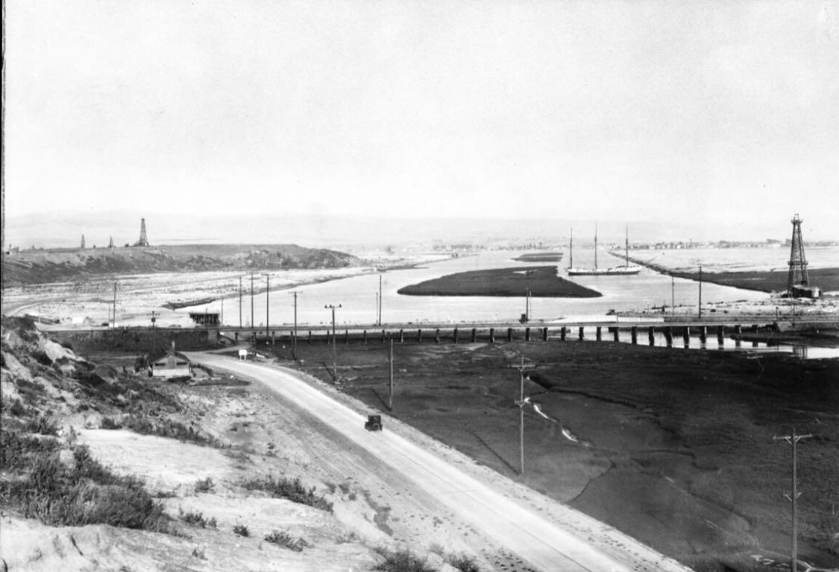
Before There Were Beaches, There Were Wetlands

Slide 3
To understand oil in Newport Beach, you first have to understand the land itself.
Much of what we now consider Newport Beach—Balboa Peninsula, Lido Island, Balboa Island and all of Newport Bay—did not originally exist as firm, buildable ground. These areas began as low-lying marshes, tidal flats, and swampy wetlands, that was primarily shaped by tides.
Early Newport was a working landscape:
• Mudflats at low tide
• Shallow channels
• Seasonal flooding
• Soft, unstable ground
Newport Beach did not become what it is today by accident. It was shaped—physically, economically, and culturally—by layers of history that include wetlands, dredging, speculative drilling, forgotten wells, and eventually, residential development.
Oil is part of that history.

Slide 4
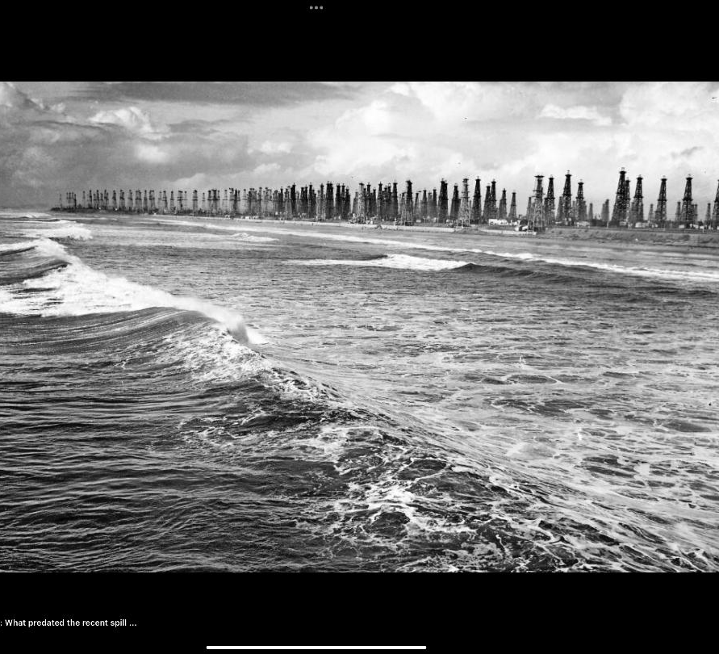
Why Wildcatters Were Drawn Here

Slide 5
In the early 1900s, Southern California was gripped by oil fever. Discoveries in Los Angeles, Signal Hill, and Huntington Beach created a belief that oil followed predictable underground structures—particularly faults.
One of the most important was the Newport–Inglewood Fault, which runs directly through coastal Orange County.

Slide 6
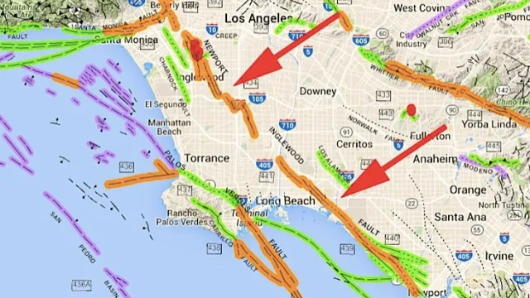

Slide 7
Wildcatters—independent, often speculative drillers—followed that fault line south.
Where a fault bends, oil tends to pool.
The Newport-Inglewood fault runs through Los Angeles and Orange County bends offshore near Newport Beach and continues beneath the ocean and then re-emerges near La Jolla as the Rose Canyon Fault.
At the time, much of West Newport and Newport Heights was:
• Open land
• Lightly developed
• Inexpensive
• Close to known oil fields
For a wildcatter, it was a logical place to drill.
Drilling began as early as 1906 according to the Costa Mesa Historical Society.

Slide 8

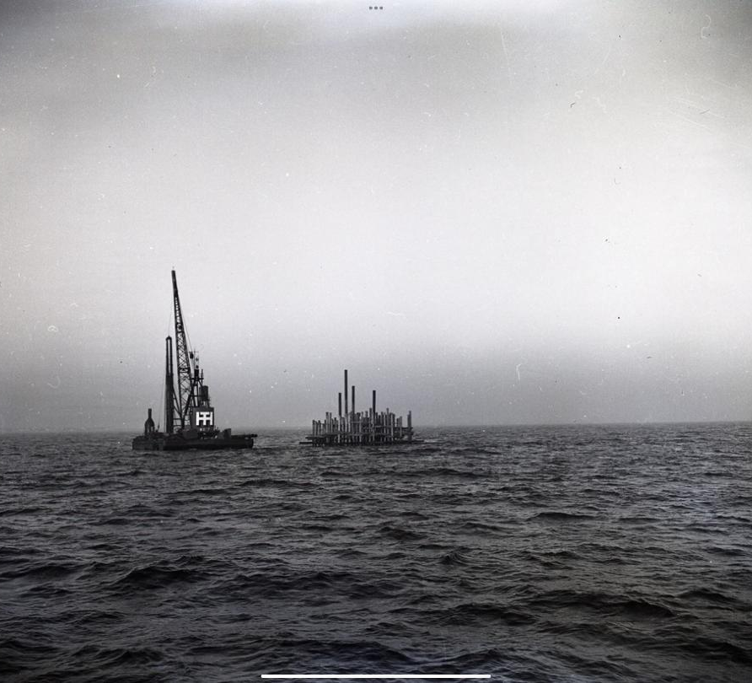
The Nature of Newport’s Oil:
Promising, But Problematic

Slide 9
Here’s where Newport’s oil story diverges from Huntington Beach or Long Beach.
Yes—oil was found.
But Newport’s oil had a problem. It was heavy, viscous, and “gooey.”
This type of crude:
• Was harder to pump
• Required more processing
• Was more expensive to refine
• Produced lower margins
In simple terms, it wasn’t economically enticing.

Slide 10
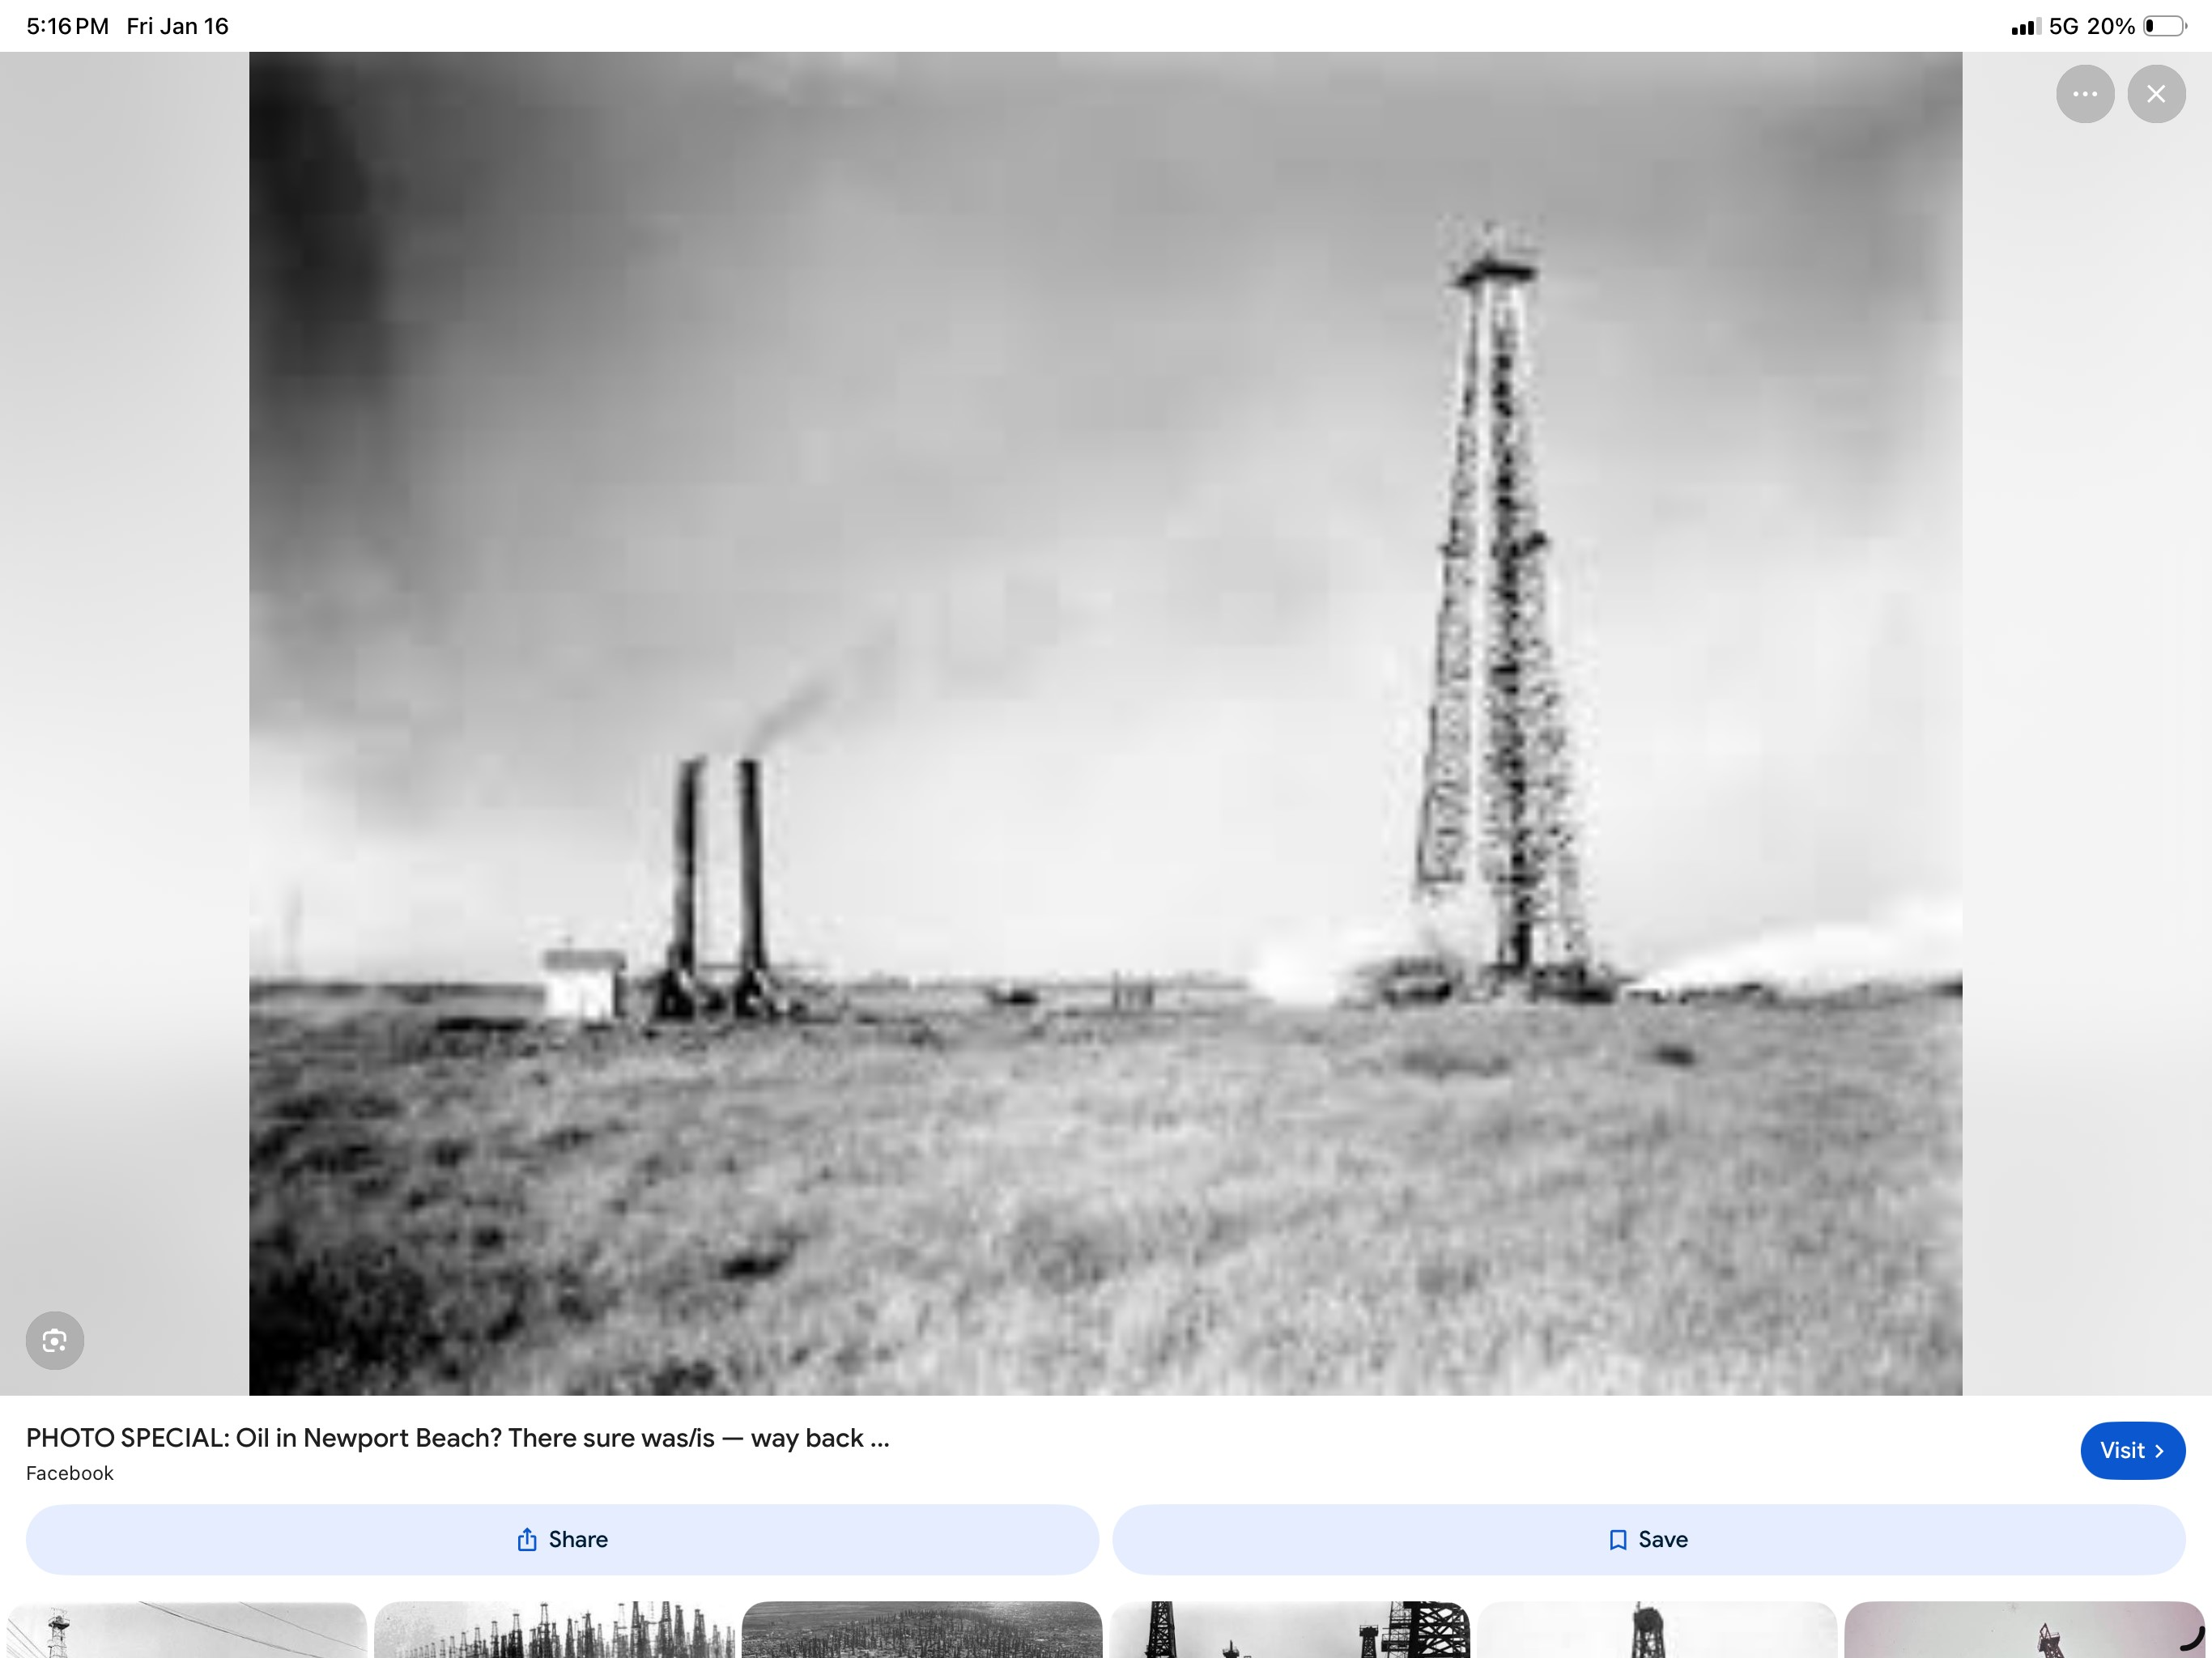
Wells were drilled throughout Newport Heights, West Newport and Costa Mesa. Some produced. But the economics were never compelling enough to justify large-scale, long-term industrial development—especially as land values began to rise.
It explains why Newport never became Huntington Beach or Long Beach. Those cities had lighter, more commercially viable crude. Newport did not.

Slide 11
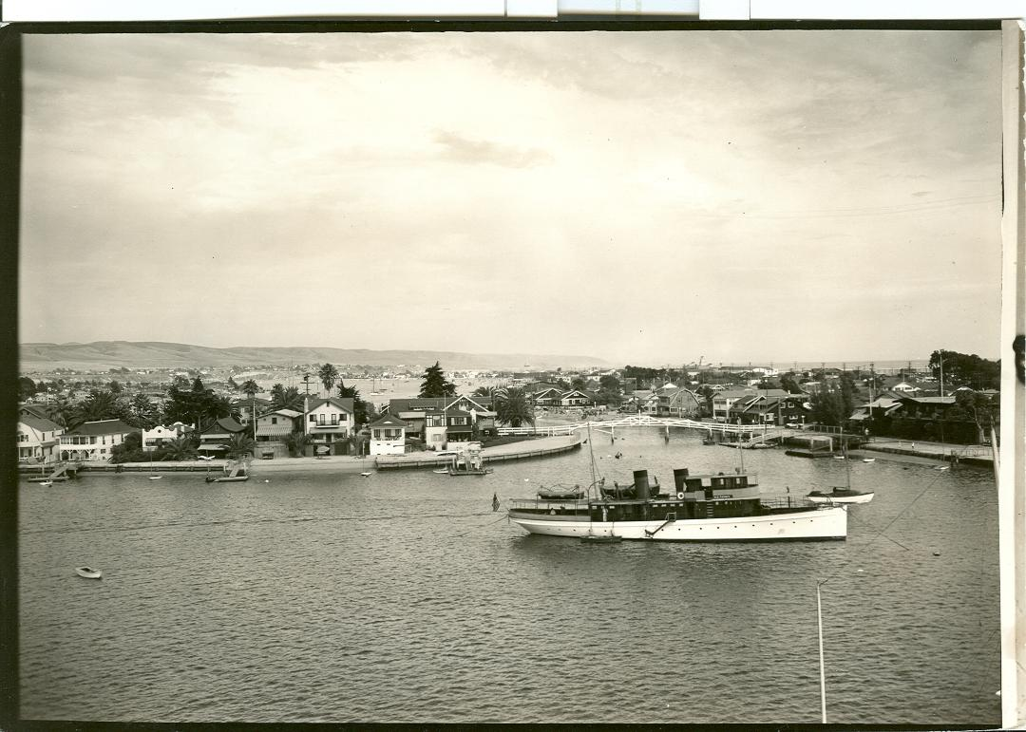
When Newport Became More Valuable as a Place to Live

Slide 12
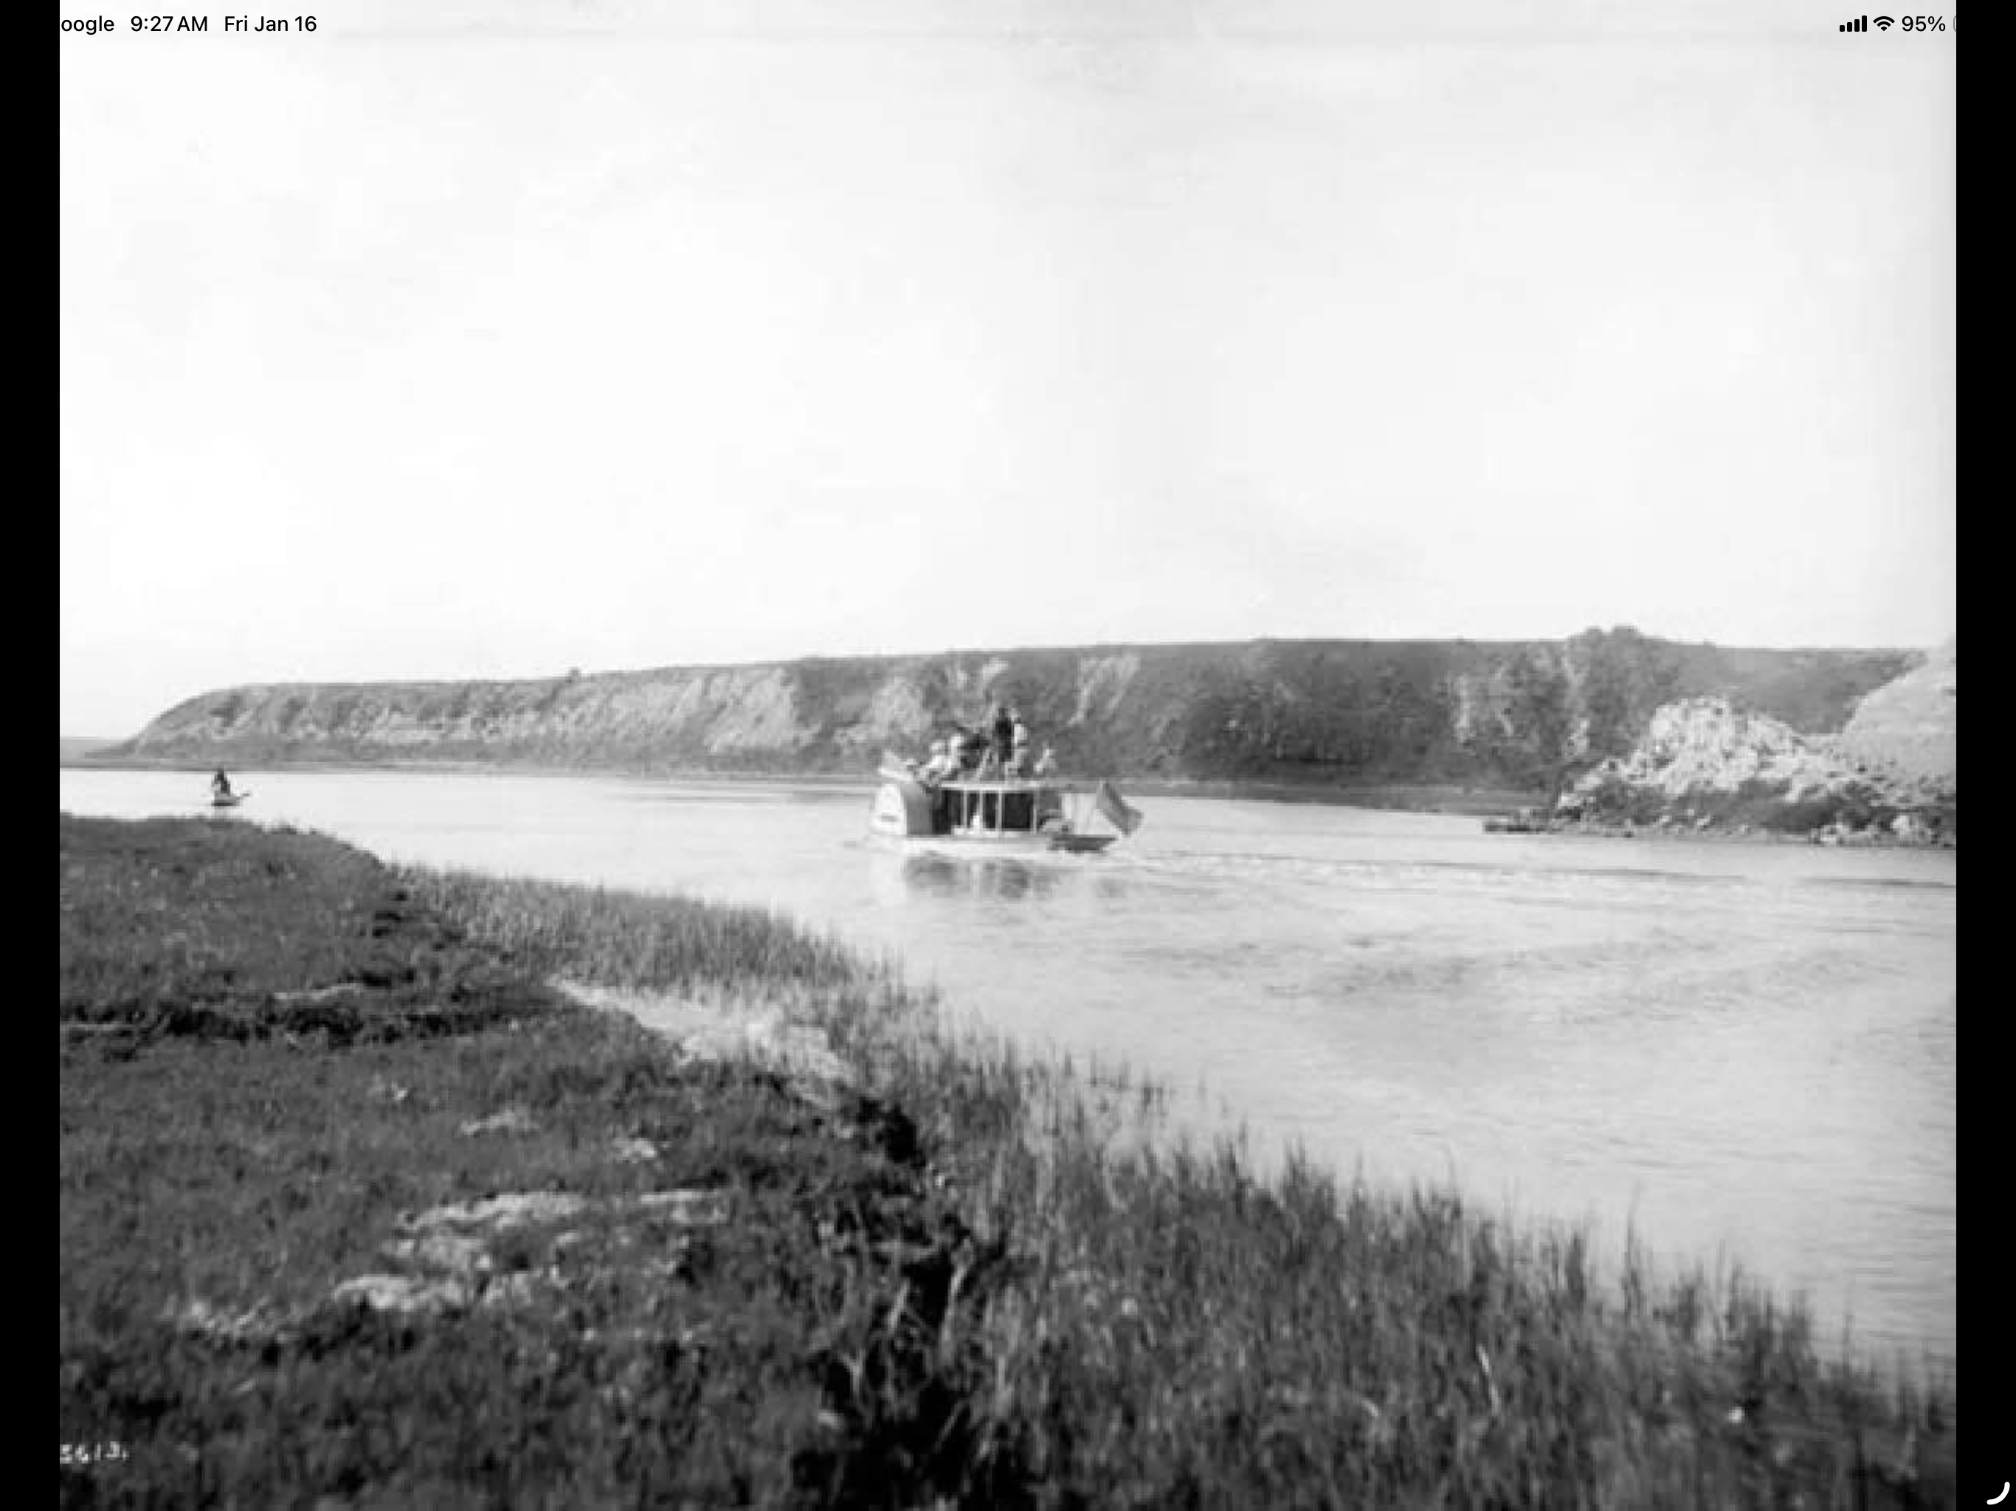
By the 1930s, Newport Beach was no longer just a speculative frontier. It was becoming a destination.
The harbor was improved by dredging and filling the wetlands.
In 1920, the peninsula was re-shaped by diverting the Santa Ana River to flow into the ocean, not Newport Bay, with the construction of the Bitter Point Dam. (At the current location of Cappy’s Restaurant and Newport Shores)
Streets replaced service roads.
Residential development followed.
At that point, oil no longer made sense here.
Economically, it made more sense for Newport Beach to become a destination resort. And so, the wells were capped.

Slide 13
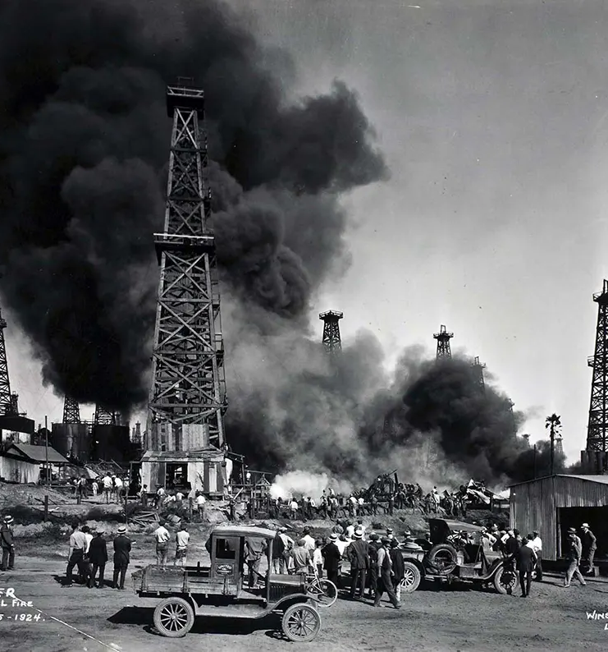
How the Wells Were Handled

Slide 14
As production slowed and development accelerated, oil wells were shut down.
Oil wells were:
• Plugged with cement
• Cut off below grade
• Locations were Documented (to the standards of the day)
• Covered by fill or pavement
Then the land was subdivided, sold, and built upon.
This wasn’t negligence—it was the normal practice for the era. No one expected these sites to resurface decades later, after generations of development.
Until one did.

Slide 15

3606 Marcus Ave
Months before October 2025, oil began seeping up from the ground into the home at 3606 Marcus Ave., not from a spill or a pipeline, but from an old, long-abandoned 1920’s- era well beneath the neighborhood.
In October, Methane gas was detected and the fear of an explosion became imminent. City officials declared a local emergency, started evacuations of several homes on Marcus Ave and began actions to seal the well.

Slide 16
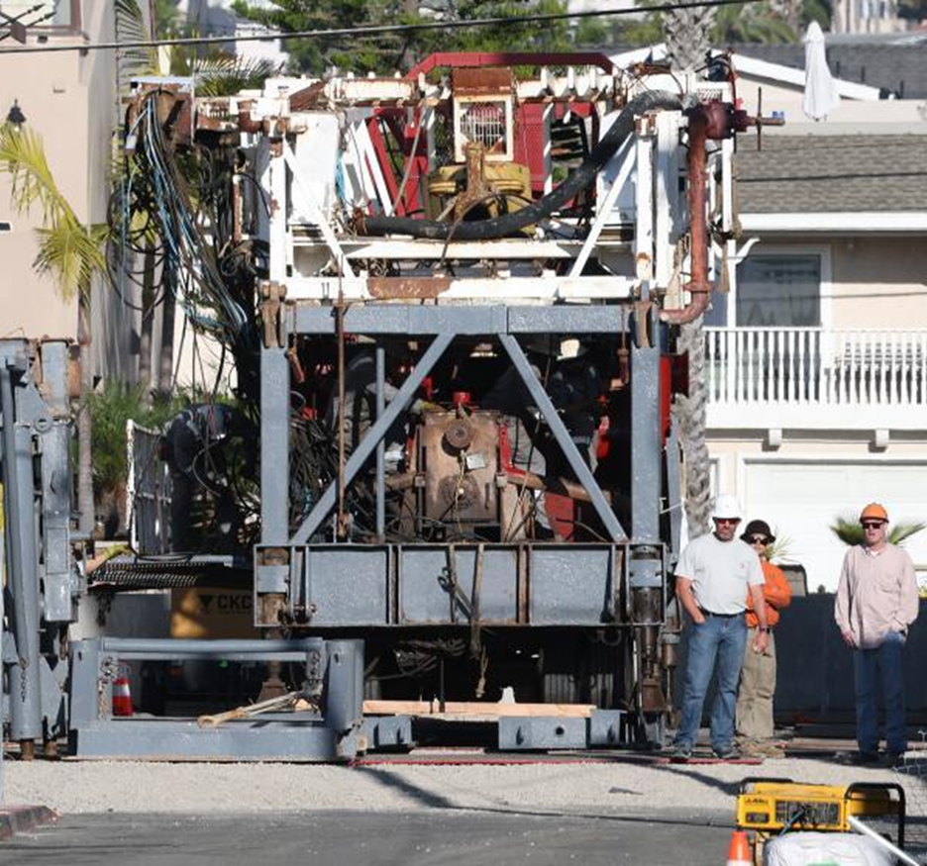
Who Stepped In—and Why?

Slide 17
The State of California maintains a dedicated fund for abandoned or “orphaned” oil wells—sites where the original operator no longer exists or records are incomplete.
Through agencies like CalGEM, (California Geologic Energy Management Division) the state:
• Investigates abandoned wells
• Oversees remediation
• Caps and seals old sites
On December 19, after drilling to a depth of 500 feet CAlGEM determined that they were parallel to the old pipe but were unable to drill into the pipe.

Slide 18
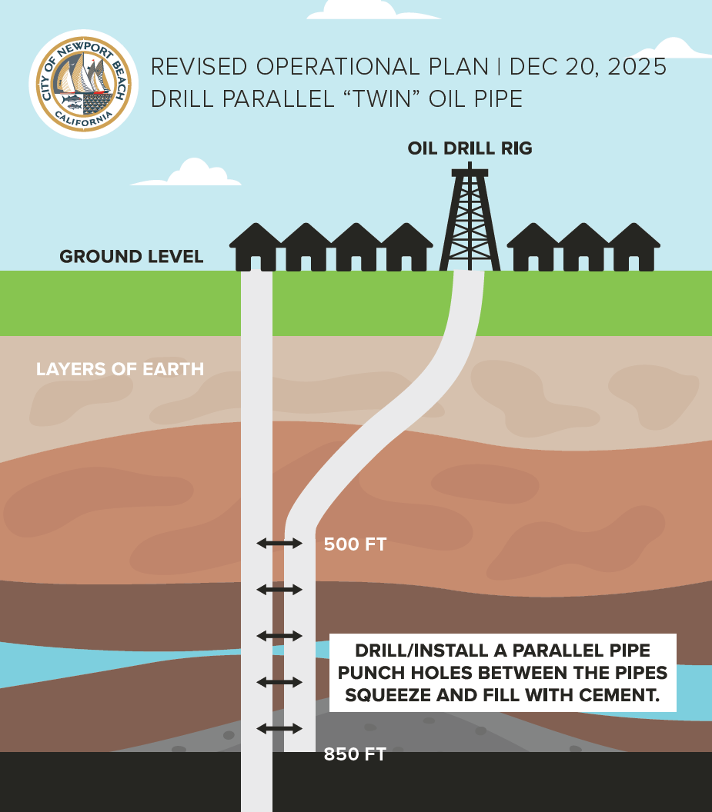
From December 20 until January 2, an alternate plan was created to drill and install a parallel pipe right next to the old original to a depth of 850 feet.
The contractor then punched a hole from the new pipe into the old. Cement was then squeezed into both pipes to create a seal and barrier to cut off the oil to the surface.
The abandoned oil well was successfully capped.

Slide 19
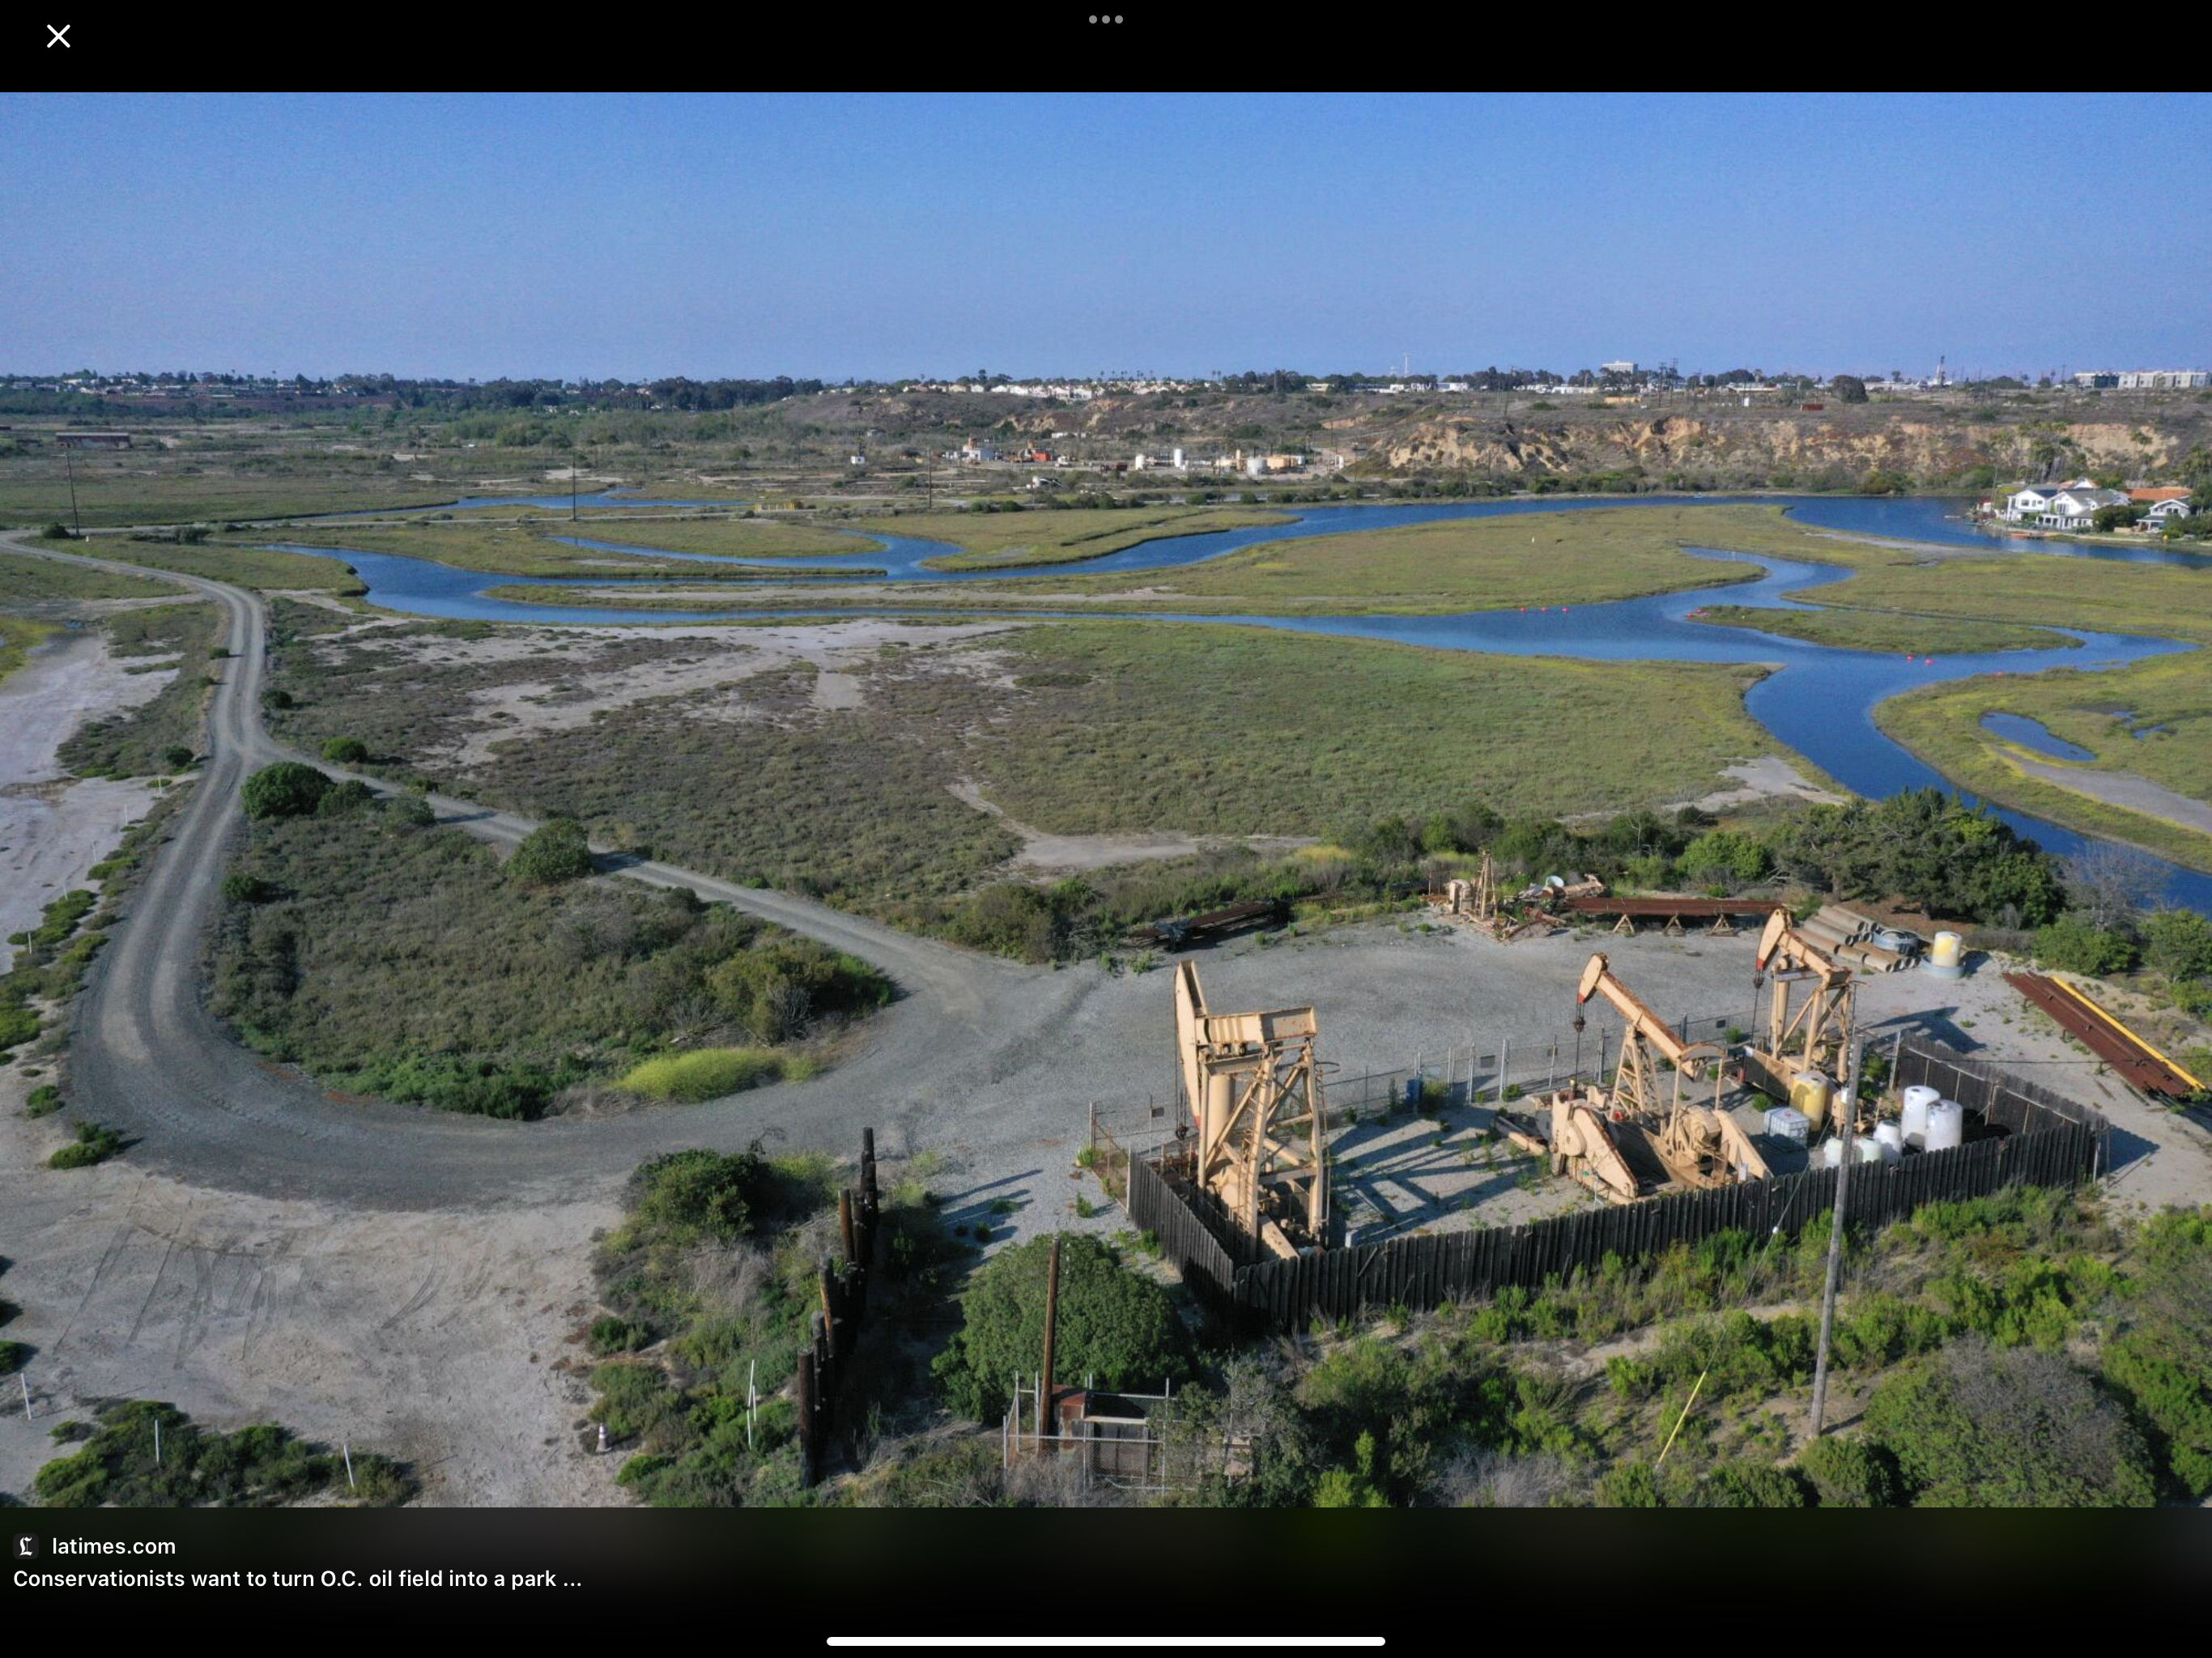
City of Newport Beach Oil & Gas

Slide 20
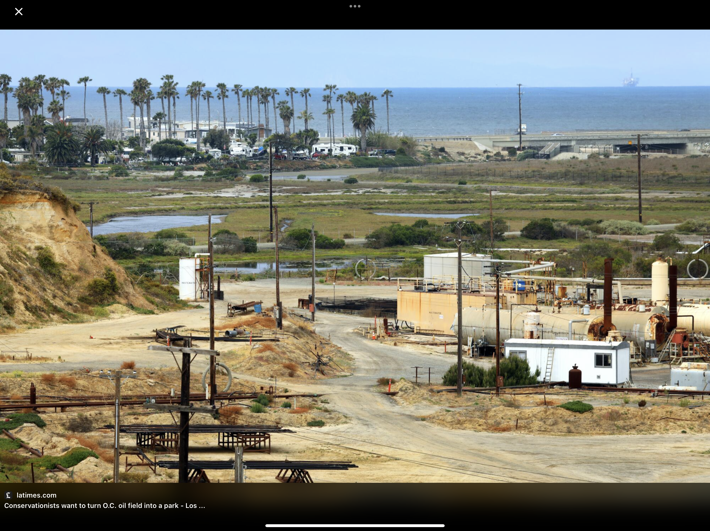
Banning
Ranch

Slide 21
The City owns and operates 14 oil wells that were drilled between 1953 and 1958. The well heads are located on two sites along West Coast Highway.
The wells are slant drilled under property within the City, into the area under the ocean which is called the Newport Offshore Oil Field.
Oil Production has declined since the 1980s (when the City acquired the wells) from approximately 60,000 barrels per year to 20,000 barrels in 2020.
In recent years, the City has been averaging approximately $1.0 to $1.2 million in oil and gas revenue a year.

Slide 22
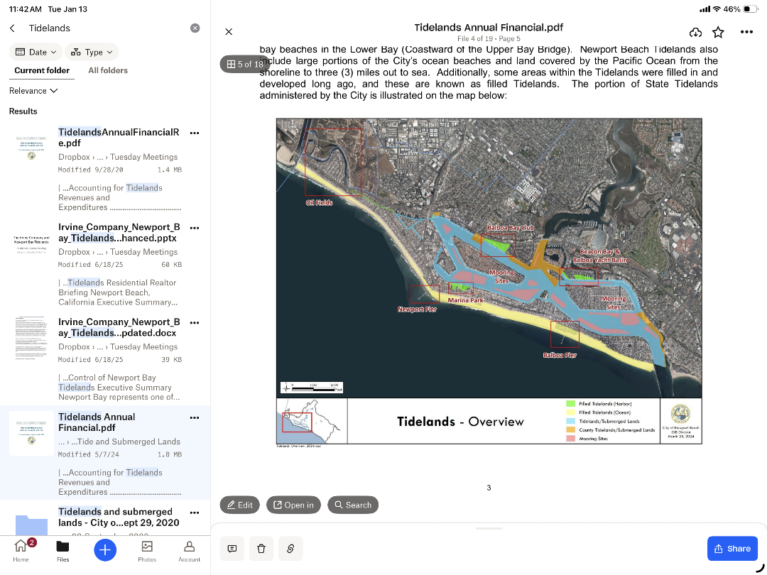
In California, tidelands (the areas between low and high tide) are held in public trust for the benefit of the people.
Oil and gas revenue is deposited into the Tidelands Fund because the source of the oil is in the tidelands area.
The Tidelands Fund may be used only for eligible expenditures that support and maintain the tidelands, such as improvements to tidelands property including dredging Lower Newport Bay, lifeguards, beach cleaning, and development and maintenance of facilities like Marina Park.

Slide 23
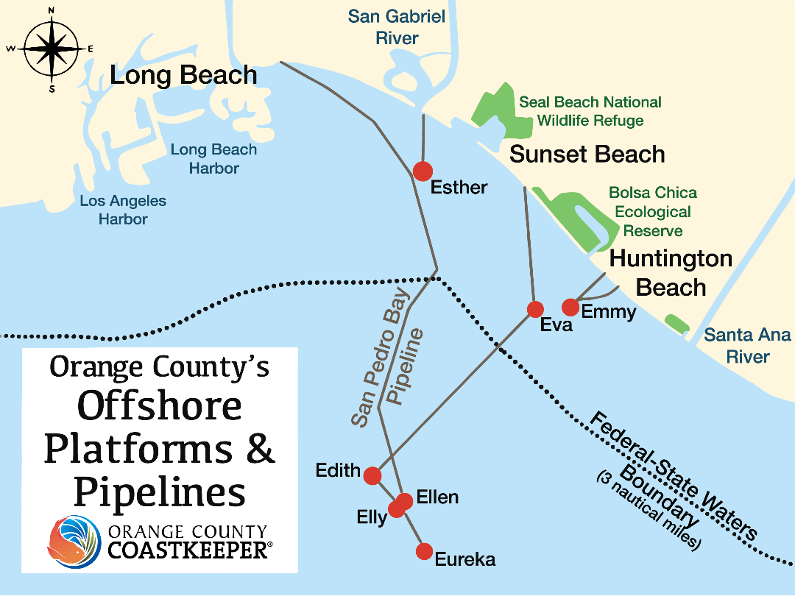
Evolution of Extraction: From Land to Offshore

Slide 24
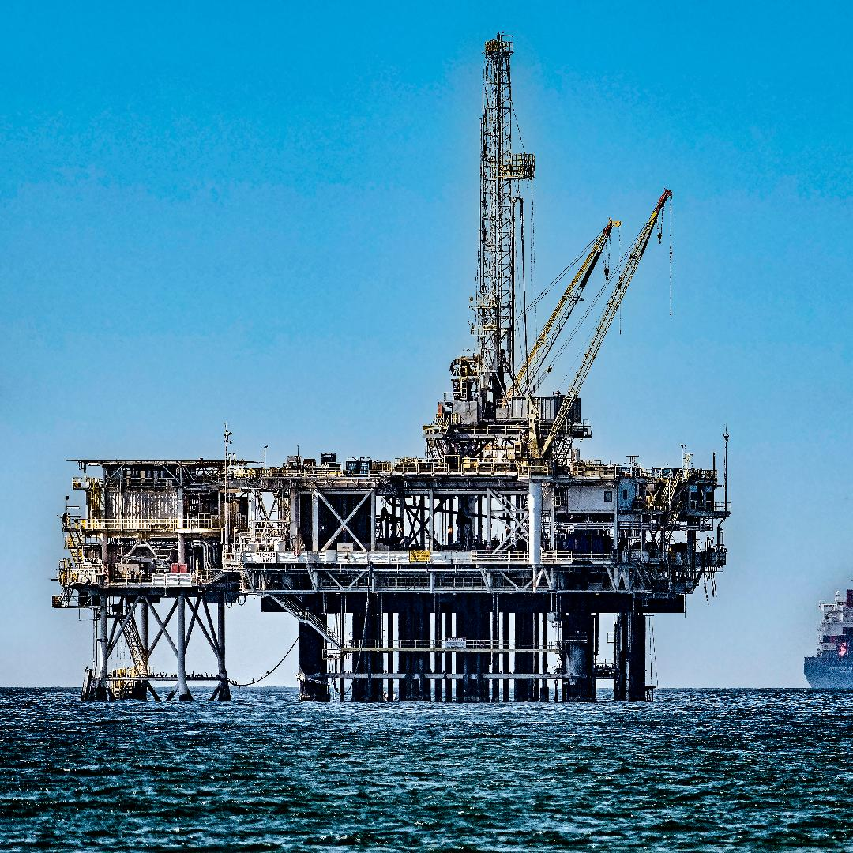
The Huntington Beach oil field and offshore platforms—illustrate how Southern California oil extraction has evolved from land-based wells to offshore directional drilling.
These offshore platforms are designed to reach beneath the seabed at angles and tap reservoirs beneath the ocean floor using advanced directional and cross-drilling techniques, allowing multiple wells to be drilled from a single structure. .
This evolution in technology and approach explains why visible oil infrastructure decreased onshore even as extraction continued offshore.

Slide 25
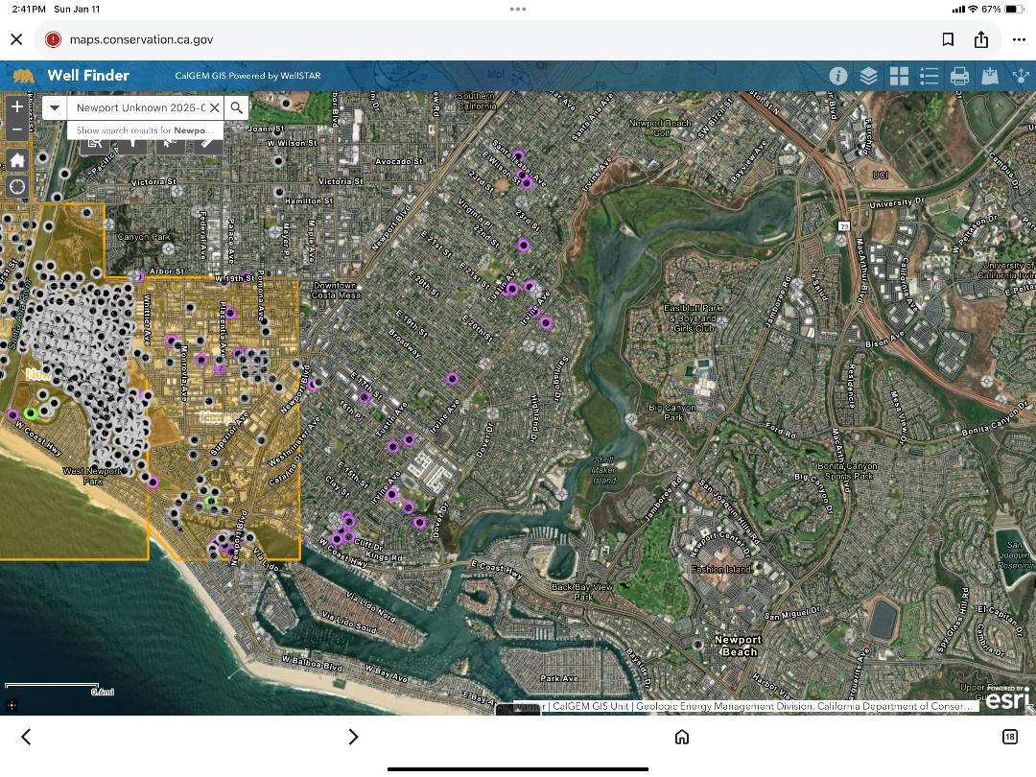
Abandoned Oil & Gas Wells – Newport Beach
KEY:
White: Plugged oil & gas wells
Purple: Idle oil & gas
Green: Active oil & Gas

Slide 26
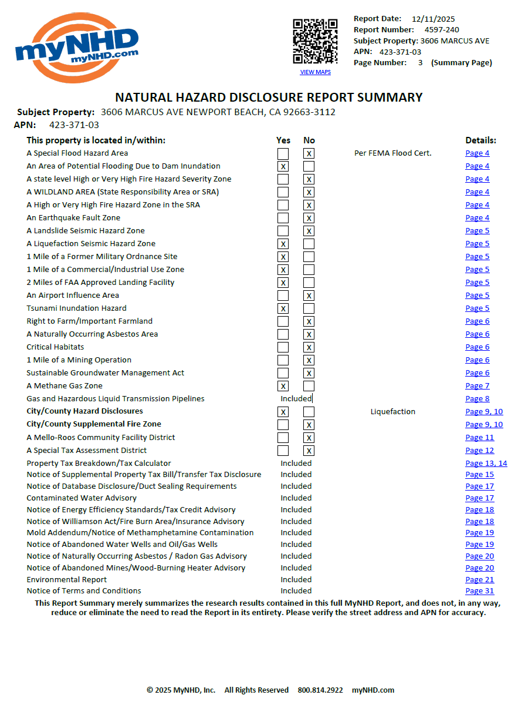
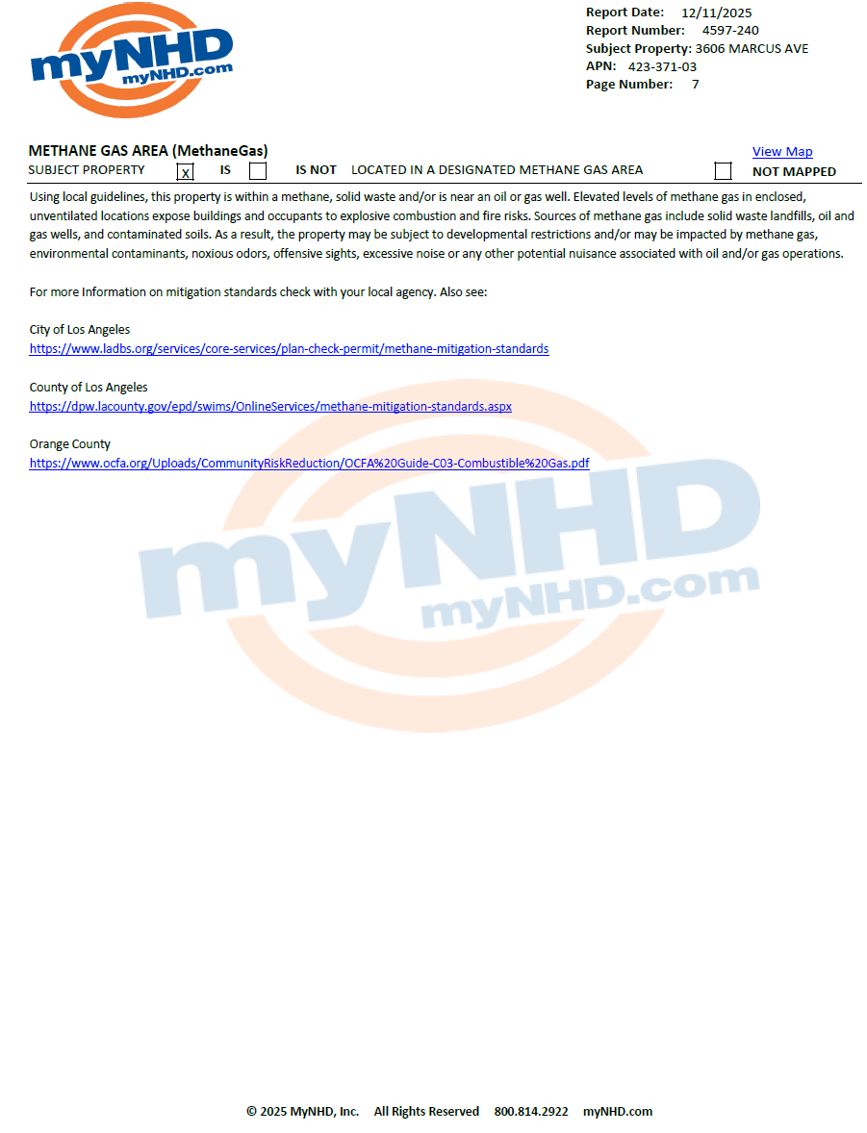

Slide 27
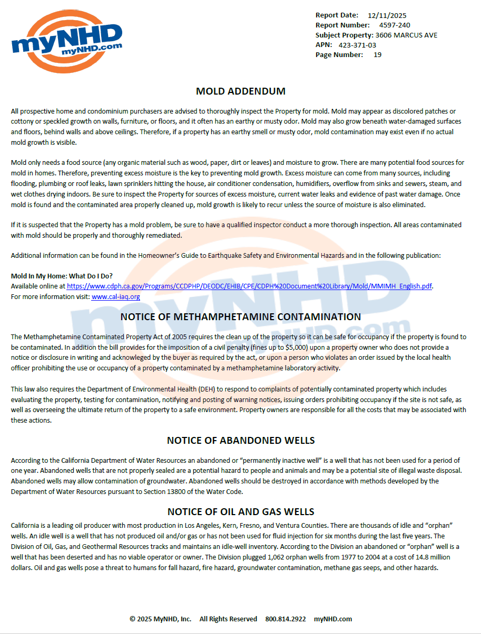
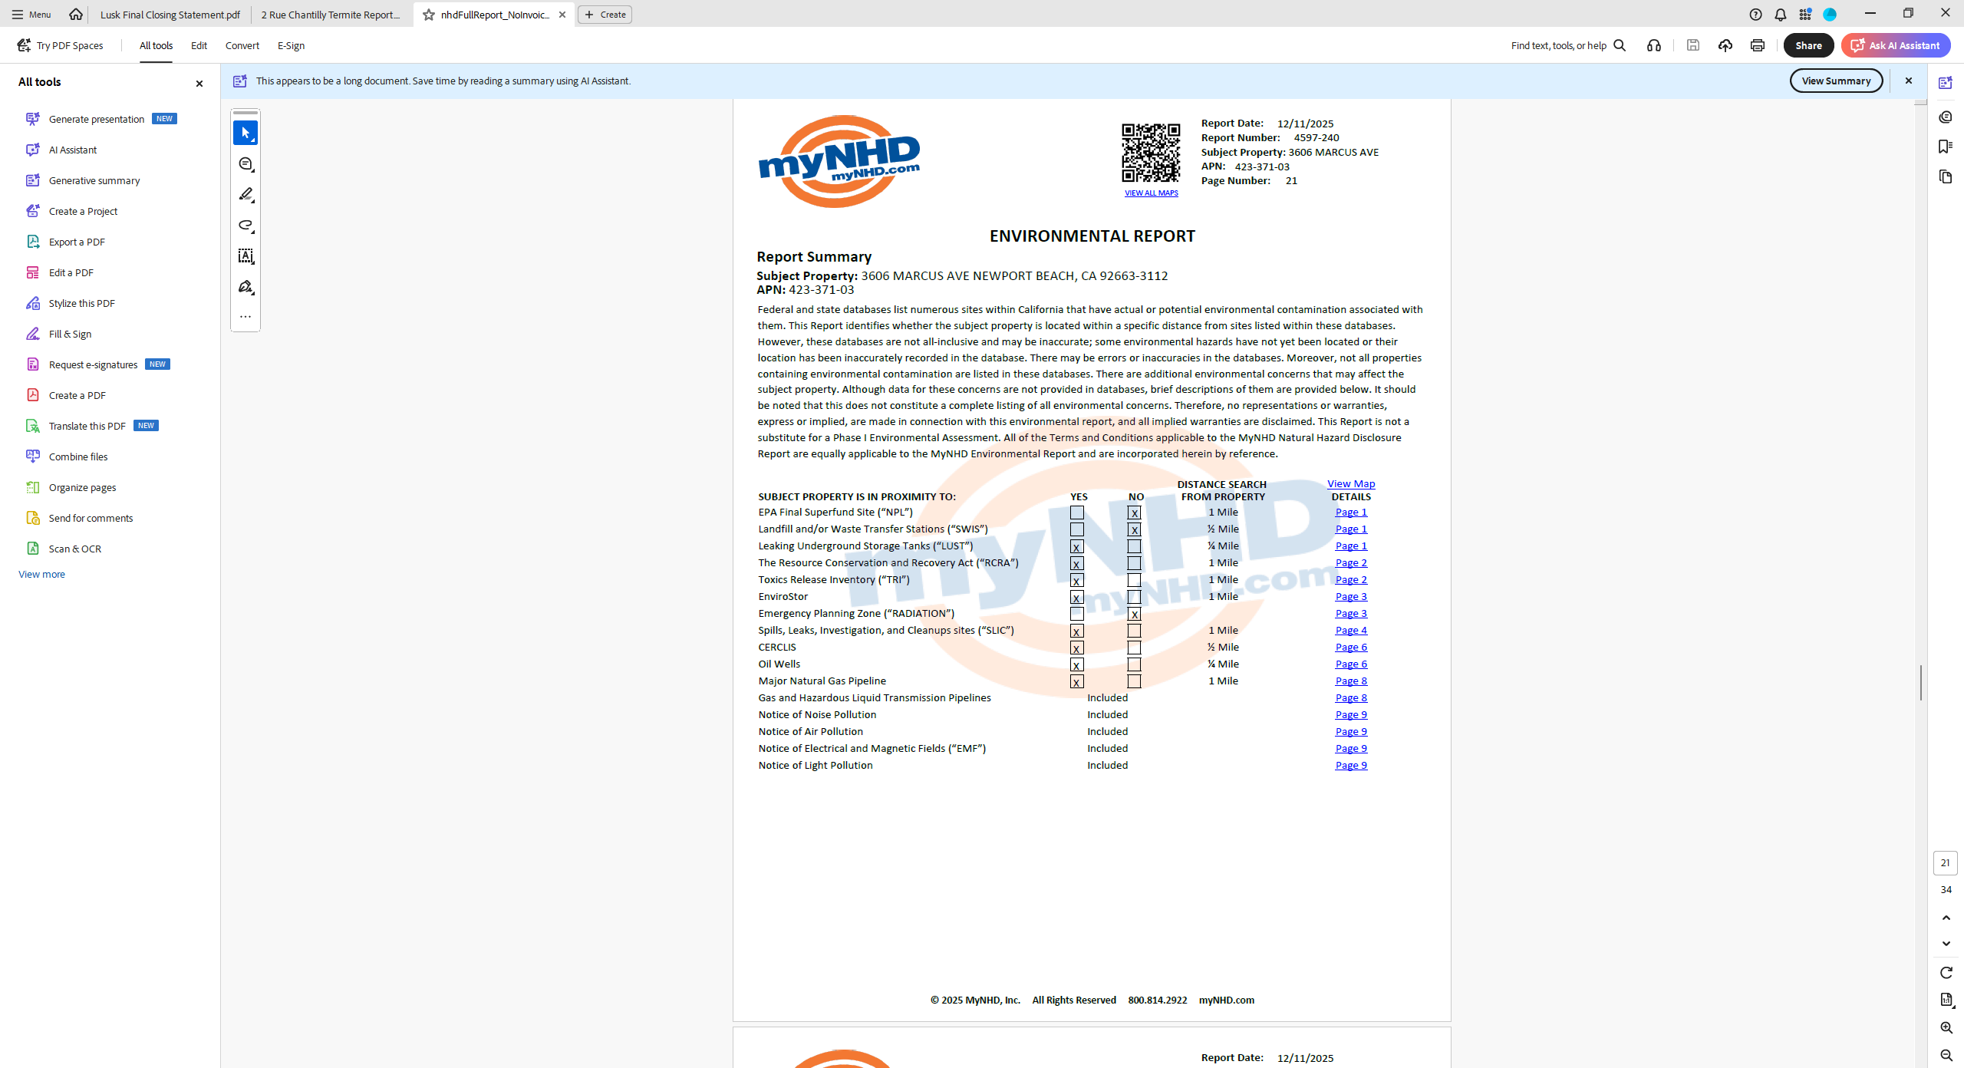

Slide 28
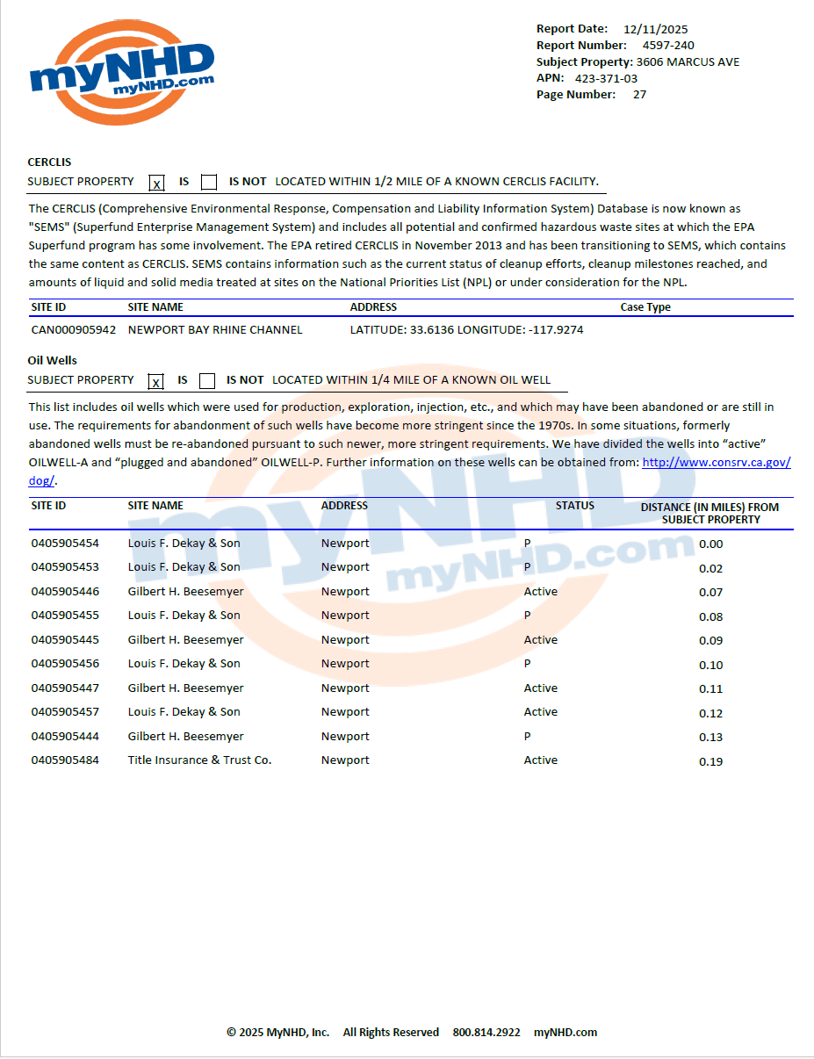

Slide 29
